Slide 1


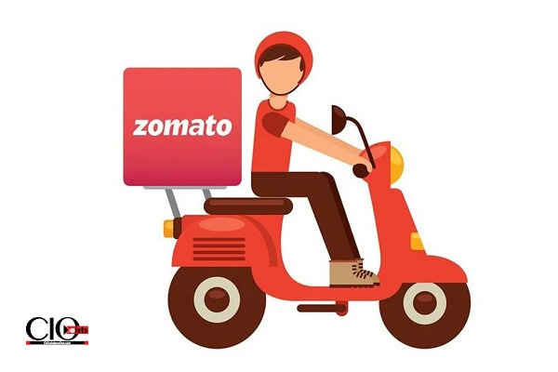
Zomato Data
Analytics
Presented By: Group 2

Slide 2


Group Members
Abhishek U B
Apurva Sarode
Ishta
Mahalakshmi Yadav
Subhisha C
Venkola Rohith Kumar
Vijaysingh Pardeshi

Slide 3


Introduction
This project focuses on analyzing Zomato restaurant data to uncover insights into global dining trends, pricing patterns, customer preferences, and restaurant performance
Using tools like Power BI, Tableau, Excel and SQL, the goal is to transform raw data into meaningful visualizations that support data-driven decisions .

Slide 4
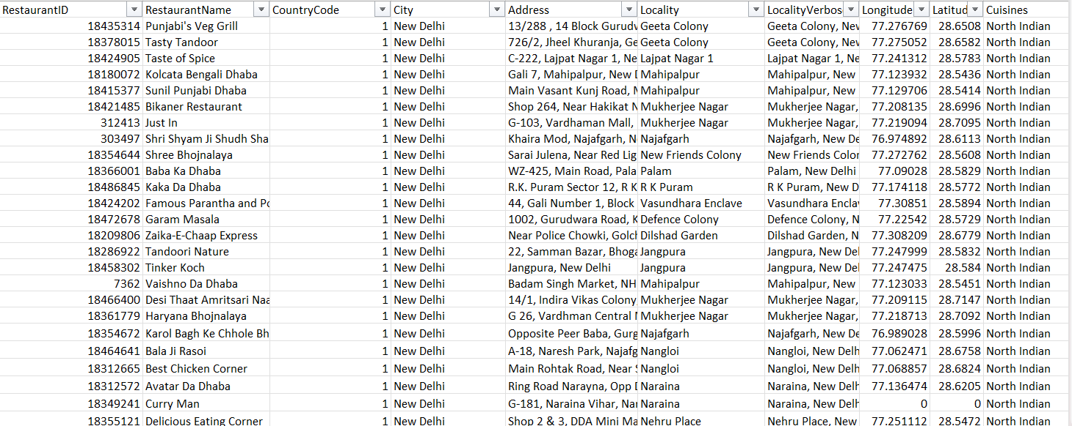
Dataset Overview
The dataset mainly includes restaurant details such as name, location, cuisines, ratings, average cost for two, and currency — covering multiple countries.

Slide 5
Data Cleaning & Preparation
01
02
03
04
Date Data
Pricing
Cuisines
Data Accuracy
Created a Calendar Table to support time-based analysis.
Grouped over 1000+ cuisines into major categories for simplified analysis:
*Indian / Mughlai *Asian
*Western *Bakery / Cafe
*Middle Eastern
*Other (remaining cuisines)..
Removed Null values to maintain data accuracy.
Standardized pricing by converting “Average Cost for Two” from local currency to USD for global comparison..
Combined Opening Year, Month, and Date columns into a single field — Opening Date.
Replaced missing cuisine values using the mode cuisine for each location, ensuring relevant substitution.

Slide 6

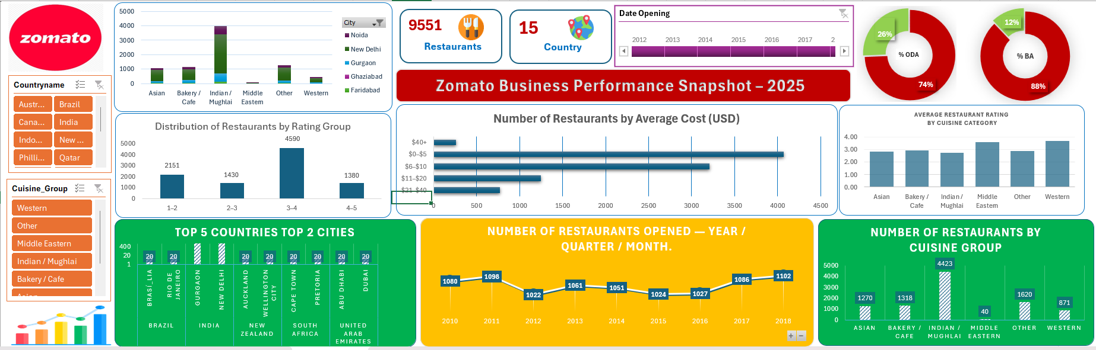
Excel Dashboard

Slide 7

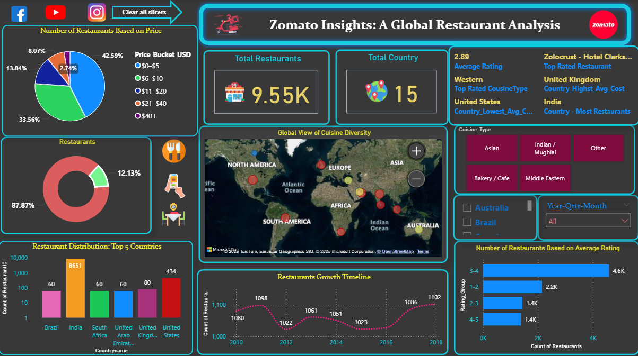
Power BI Dashboard

Slide 8

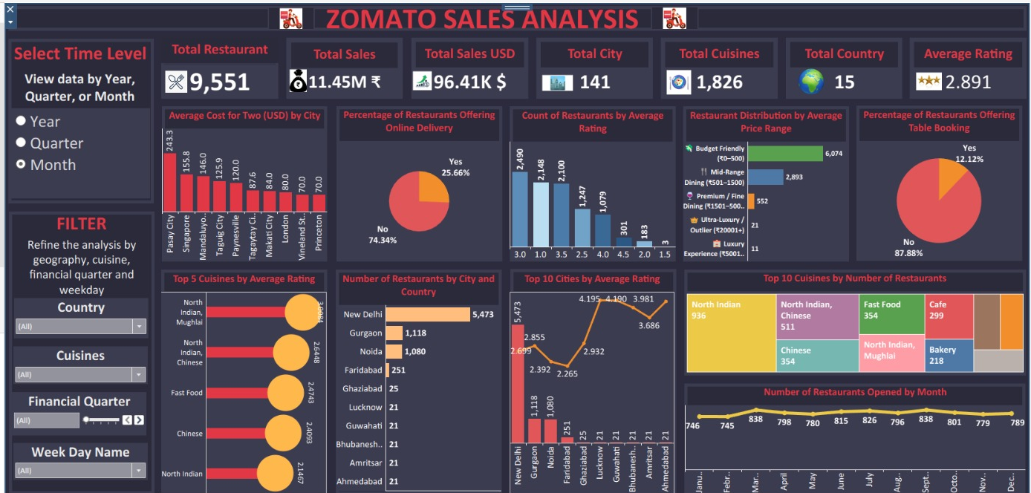
Tableau Dashboard

Slide 9

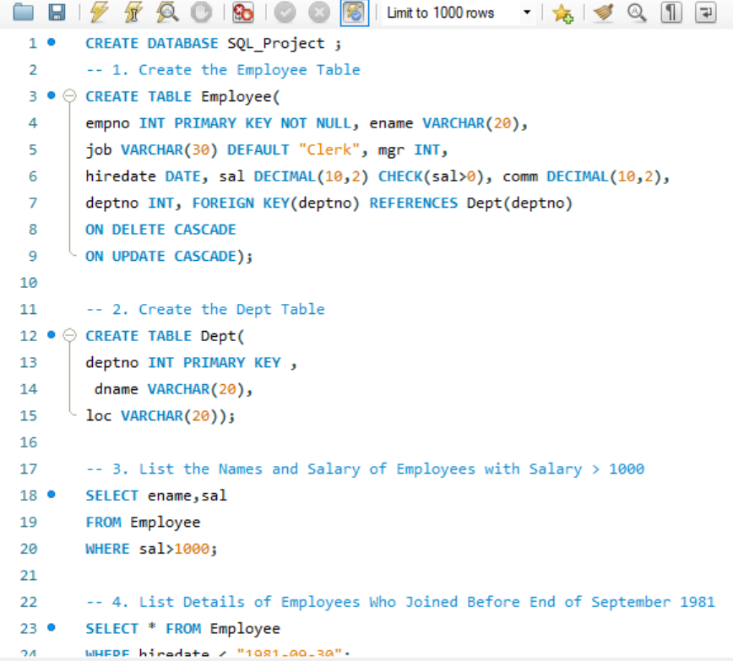
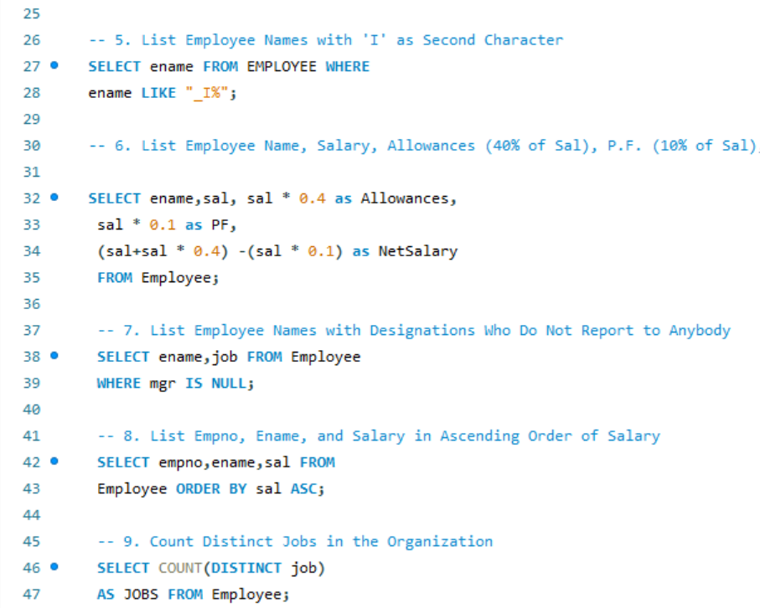
SQL Queries

Slide 10
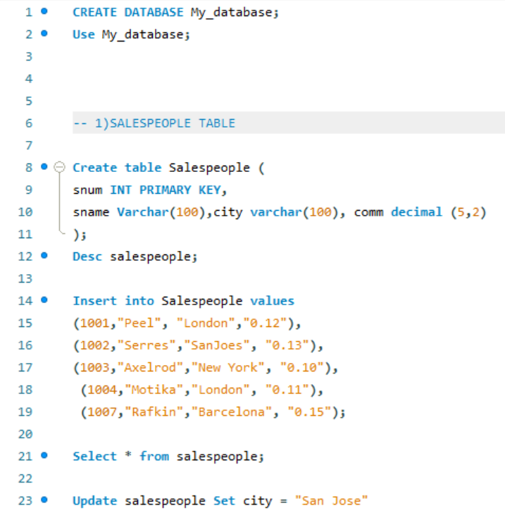
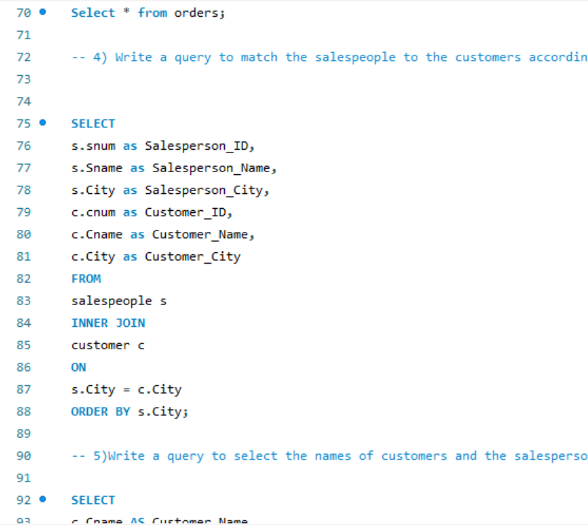
SQL Queries

Slide 11
Insights & Findings
The data shows that India dominates the dataset with 8,651 restaurants, far higher than any other country.
The United States follows with 434 restaurants, while the United Kingdom, Brazil, South Africa, and the United Arab Emirates each have around 60–80 restaurants.
.
The majority of restaurants (4.6K) fall in the rating range of 3–4, indicating average to good customer satisfaction.
Around 2.2K restaurants have ratings between 1–2, showing a significant number of low-rated establishments
The higher rating range (4–5) has the fewest restaurants (1.4K), suggesting that only a small proportion achieve excellent customer satisfaction..
The highest number of restaurants opened in 2018 (1,102)
This is 7.83% higher compared to 2012, which had the lowest count (1,022)
Indicates a steady growth trend in restaurant establishments leading up to 2018.
.
Only 26% of restaurants offer online delivery,
while the remaining 74% do not provide this
service.
Only 12 % of restaurants offer table booking, while
the remaining 88% do not provide this option.
.
India, USA, Brazil, UAE, and UK have the widest range of cuisine types, each featuring more than five cuisine categories — reflecting strong cultural diversity and global dining influence
Canada, on the other hand, shows the least cuisine variety, with restaurants offering primarily Asian and Western cuisines.
.
A majority of restaurants (42.59%) fall within the $0–$5 price range, indicating that most dining options are budget-friendly.
The premium segment ($40+) is the smallest, making up just 2.74% of total restaurants
.
Average Rating : 2.9
.
Country_LAC : USA
Country_HAC :UK.
Top Rated Cuisine Type: Western
.
Country with most number of Restaurants : INDIA

Slide 12



Business Recommendations
Focus on India: Since India has the highest number of restaurants, Zomato should keep improving its services, partnerships, and customer experience there.
Expand Globally: Countries like the US, UK, and UAE have fewer restaurants — Zomato can work on expanding its presence and attracting more partners in these regions.
Improve Service Options: With only 25% offering online delivery and 12% offering table booking, there is a strong opportunity to encourage more restaurants to add these services for better customer convenience.
Support Low-Rated Restaurants: Most restaurants fall in the 3–4 rating range, so Zomato can help lower-rated restaurants to improve quality through customer feedback and insights
Cuisine Insights: Countries with limited cuisine variety (like Canada) can introduce new cuisines, while diverse markets (like India and the US) can promote popular local dishes.

Slide 13
Limitations & Disadvantages
Limitations:
Dataset is static and not updated in real-time, it may exclude newly opened restaurants.
Dataset lacks direct customer-level insights such as sentiment or behavioral patterns
Limited analytical coverage — focused mainly on restaurant count, cost, and ratings.
Disadvantages:
Excel dashboard has limited interactivity and scalability for large datasets.
Power BI : Limited Custom Visualization Flexibility and Performance issues with large dataset and complex visuals.
Tableau: Limited Real-Time Data Handling

Slide 14

Conclusion
The analysis of Zomato restaurant data helped us understand important trends in pricing, ratings, cuisines, and services across different countries.
It shows that India has the strongest restaurant presence, while other countries still have room to grow.
Improving online delivery, table booking, and customer experience can help Zomato and its partner restaurants reach more customers and grow globally.

Slide 15
Thank You
From
All Group 2 Members

